Slide 1
Food & Drink application
A first look at agile software development and integrating external API’s.

Slide 2
Christopher Scott, Esmail Mahbub, James Louis, Mackenzie Clark, Nargiza Boronchieva, Nicole Graiff, and Samson Wong

Slide 3
Elevator pitch
Notes:
Our objective was to delve into the world of agile software development with a team building project designed to test our skills in front-end development and begin to familiarize ourselves with building applications using API’s. We identified and designed for a user story. We then ideated on an MVP solution using public APIs. Through our development process, we were able to prototype a lean execution of an application to meet the defined user’s needs. We have successfully deployed a functioning application that will allow a user to search databases of recipes and save their favorites to a user profile using local storage. Our next phase of development is to test our prototype and continue the design thinking process to further advance the effectiveness of the user’s experience.

Slide 4
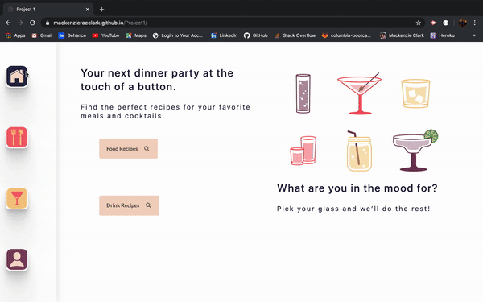
Concept
Notes:
Our application includes a simple, responsive user interface and the ability to store local data to a user profile. We based our project on two API’s housing recipe data for meals and cocktails. A user can search by name or ingredient, view the recipe’s directions and ingredient measurements, and save their desired recipes by toggling a star. The user then has access to their saved recipes and can view them on their user profile.

Slide 5
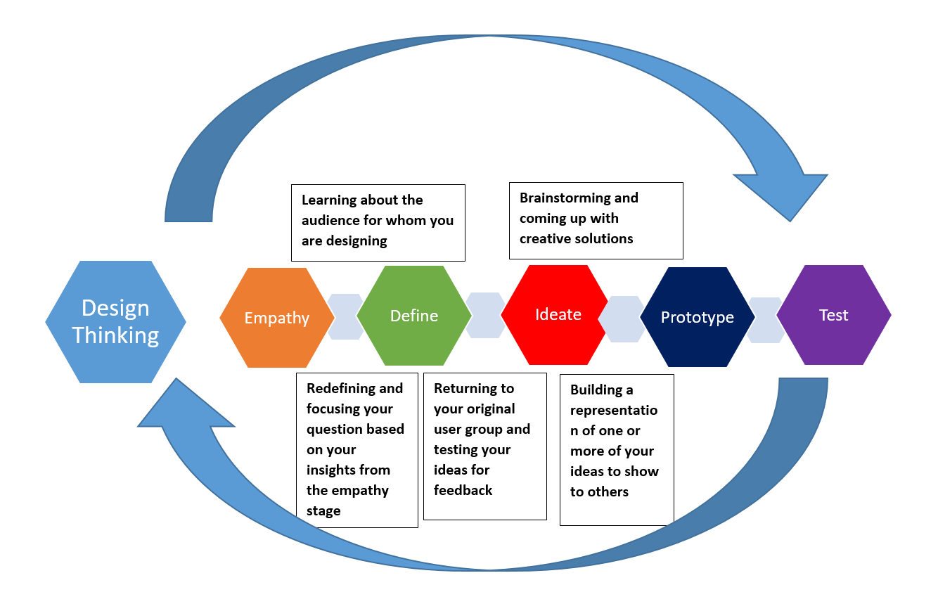
Concept
Design Thinking:
How might we design, build, and deploy an application as a viable solution for a targeted user audience.
Motivation: To assess a user story and create an application that implements two relevant API’s.
Notes:
We used the design thinking process to ideate a solution for our user. This process is ongoing, using rapid prototyping and frequent testing to continuously and meticulously develop an effective and elegant application. Our motivation for this project was two-fold. We needed to not only ideate for a solution to a potential user story, but also successfully implement two relevant and complementary API’s for our database.

Slide 6
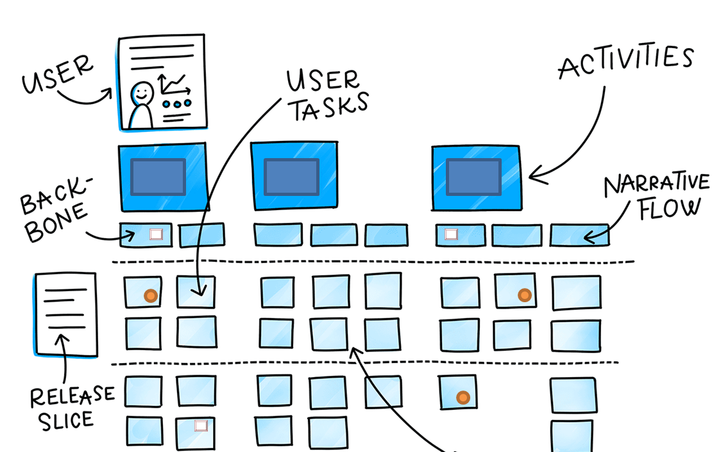
Concept
Defining our User’s Story:
“As a party host, I need a simple, personalized menu planning application, so that I might organize and execute a successful event.”
Notes:
During our first meeting, we were able to discuss possible cases of users and define a working user story to construct our application around. We agreed on two major functionalities that would address the users’ needs. The first being an application capable of searching and viewing a database of both food and drink recipes. The second being a feature to save recipes so that the user could personalize their application experience and come back to specific recipes instead of having to start a new search.

Slide 7
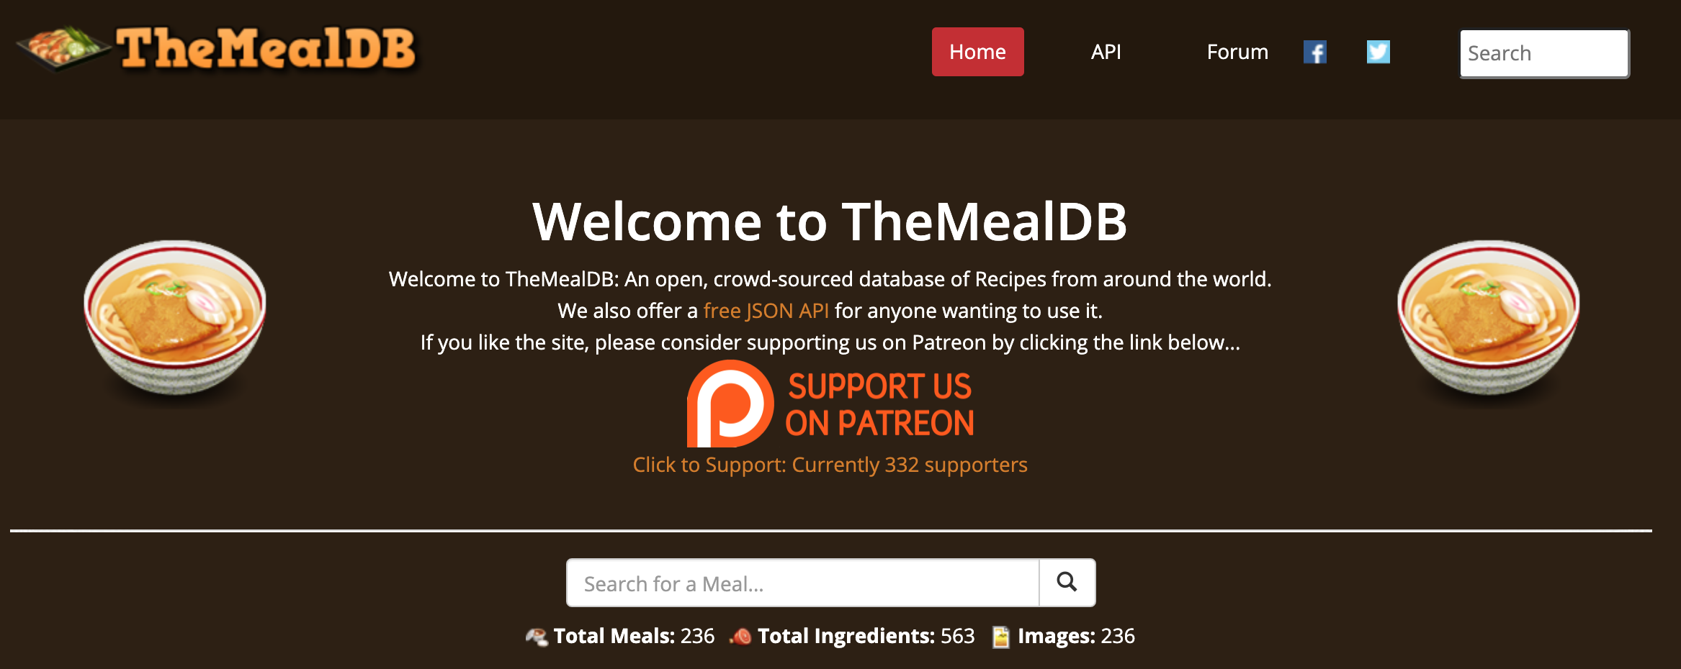
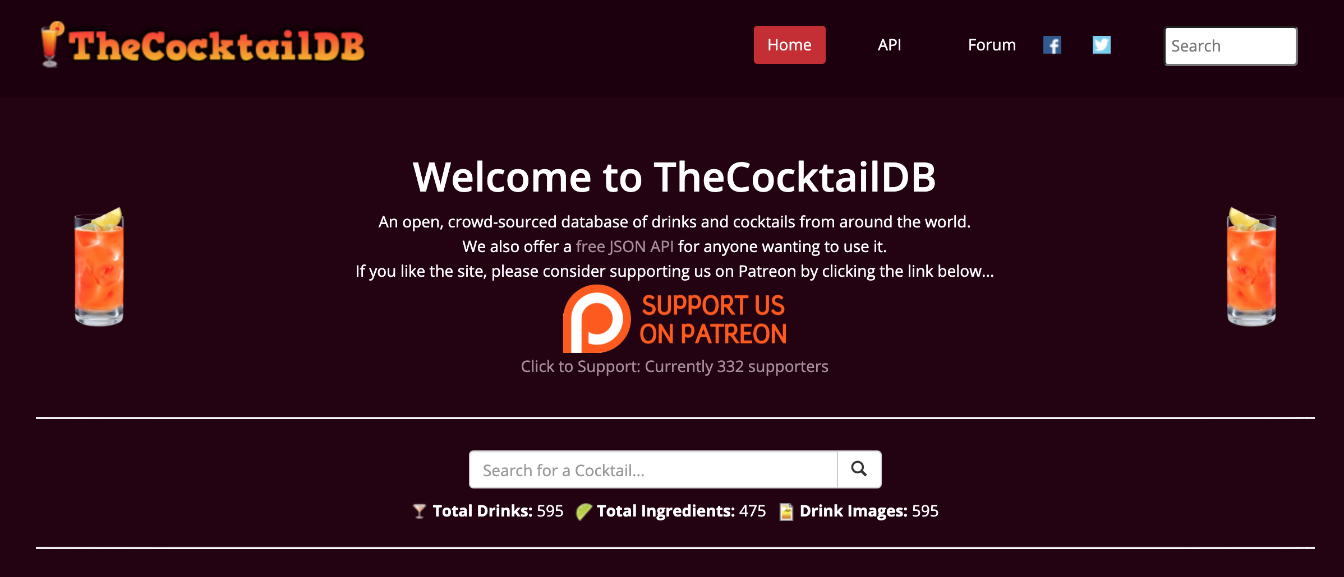
Process
APIs: The Meal DB The Cocktail DB

Slide 8
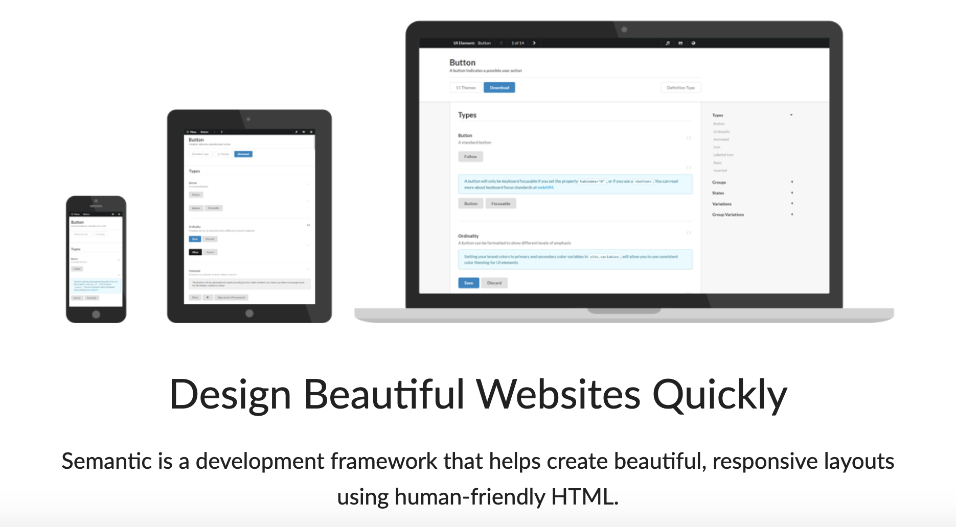
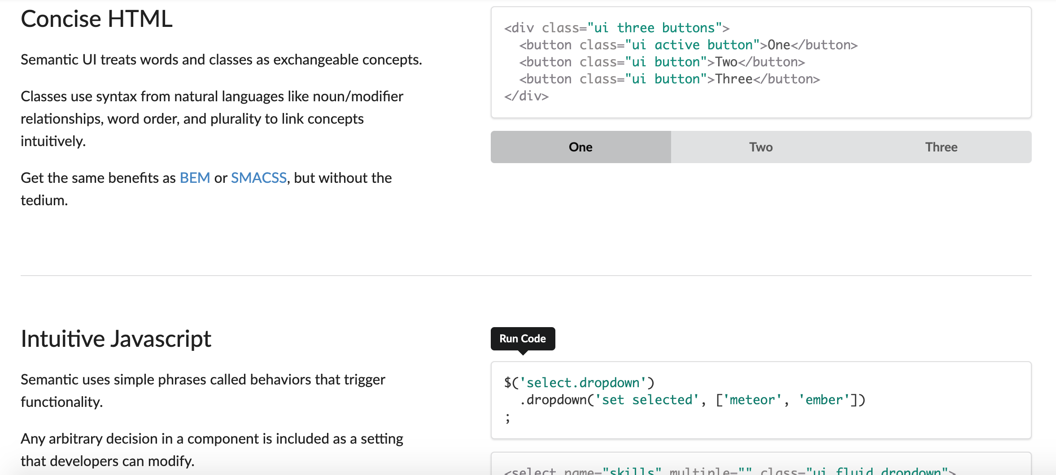
Process
CSS Framework: Semantic UI

Slide 9
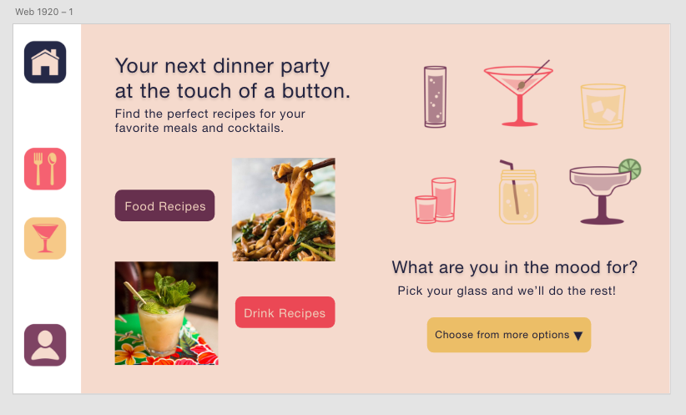
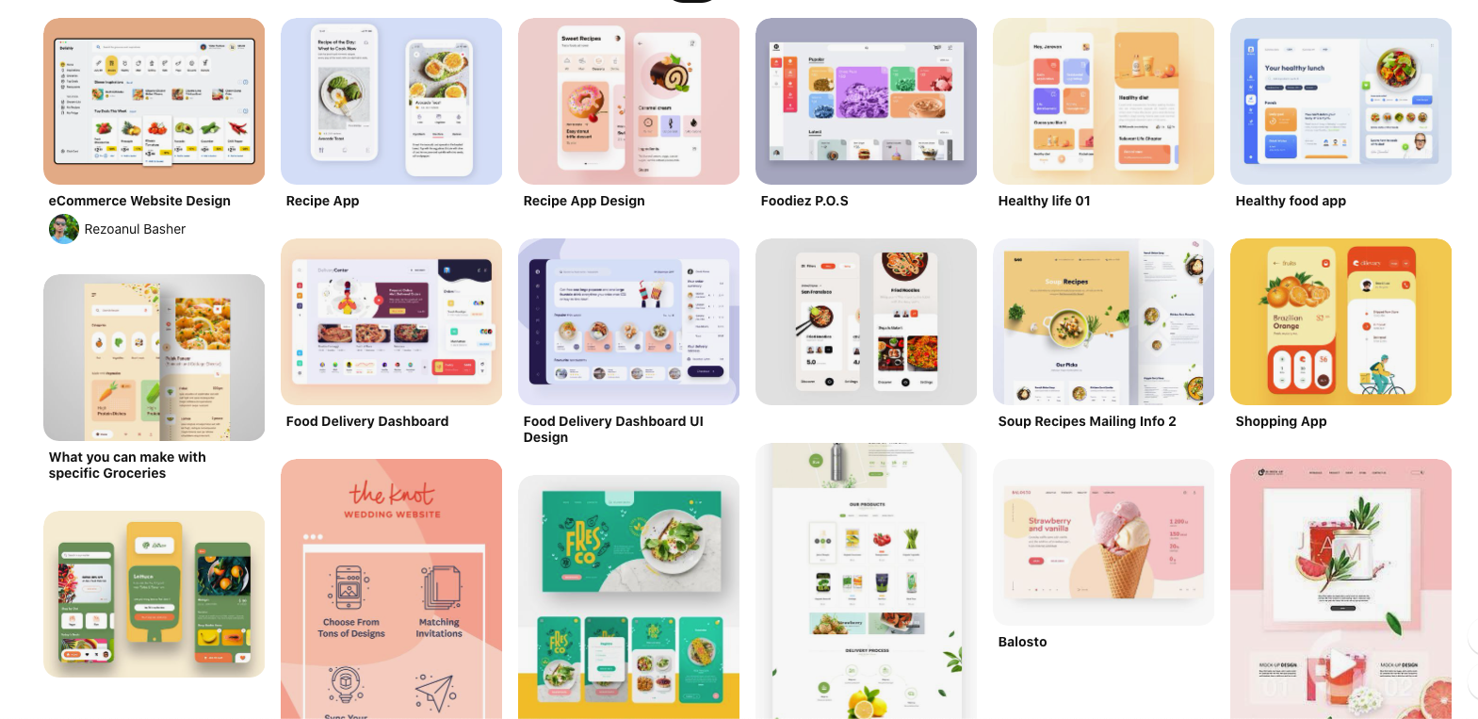










Process
Design Research: Understanding industry trends and common practices

Slide 10
Process
Challenges
Semantic UI: Achieving responsiveness seems to require more work and a deeper understanding of the framework. It proved to be a challenge during this project and requires further refinement beyond this presentation.
Lessons learned: Focusing more heavily on function created some tricky and time-consuming display challenges down the road. On our next project, dedicating some more time to fully fleshed out wireframes (from start screen to finish) could save time and trouble in the long run.
Successes
We were able to successfully call for data from our API’s and fill designated object arrays with the data to be used for the site.
As a team, we were able to learn from each other, push each other to learn new technologies and frameworks,, and test our “google-ninja” skills to discover completely new information and tactics.

Slide 11
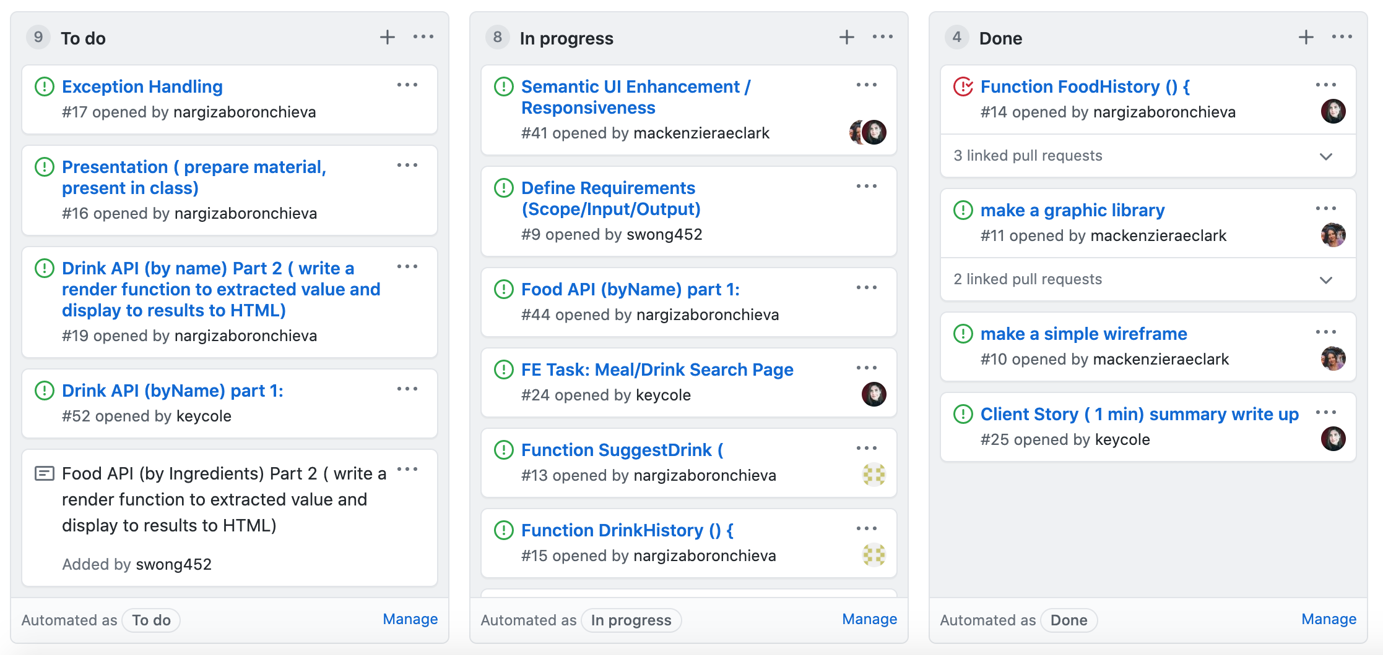
Process
Create a lean development development process with a native Github kanban management tool
Notes:
We tried to keep our roles as fluid as possible and play to our strengths. Our team members collaborated on front-end development as well as worked on javascript functionality. We spent the first weekend working through our design, outlining our desired page structure, and learning how to best utilize our new css framework. We have spent the rest of the project time working through our functions, making sure our API calls were successful, and continuous debugging as the project materialized.

Slide 12
Process
Analyzing the Code
Data structure
Dynamic property naming scheme
Html display based on parent elements clearing out all child elements
Notes:
TBC: Samson’s discussion of code

Slide 13
Data Structure
1 x object to represent a meal; with various properties
// Data structure of each single meal
// var mealObj = {
// mName: "Fried Chicken",
// mRecipe:"Pour 2 x cups of water, mix it with milk….",
// mIngreQty:[{mIngre:"lemon", mInQty:"4 tspn"}, {mIngre:"Chicken", mInQty:”2 cups"} ],
// mPic:"https://…..",
// mIngLen: 12
// mID: 2
Notes:
TBC: Samson’s discussion of code

Slide 14
empty() trick
Use empty() on an element, to clear out all the older content
But after clear, the next append statement does not append anything on the screen
Turns out, empty() will clear all the child elements that are supposed to be the ‘anchor’ , or div; where the next append needs to add the items to.
Notes:
TBC: Samson’s discussion of code

Slide 15
API Object Key name : variable
Unknown number of ingredients
Key name is a variable, depending on number of ingredient
Use [ ] Bracket notation to reference to a variable property
function pIngredient(fObject, mealObj, mealCnt, index) {
var ingre = "strIngredient" + index;
var ingreQty = "strMeasure" + index;
// If ingredent field is not blank AND searched <= max 20
while ((fObject.meals[mealCnt][ingre] != "") && (index <= 20)) {
// create Dict for Ingredient/Qty, on that index (ingredent #)
mealObj["mIngreQty"][index] = {};
// assign Ingredient Name, and Qty to this new key/value pair.
mealObj["mIngreQty"][index - 1] = {
'mIngre': fObject.meals[mealCnt][ingre],
'mIQty': fObject.meals[mealCnt][ingreQty]
};
Notes:
TBC: Samson’s discussion of code

Slide 16
Demo

Slide 17
Directions for Future Development
Drink By Mood
Idea: To assess a user’s facial expression and generate a recipe based on that emotion. For example, if the user looked sad, suggest a comfort food recipe.
Samson’s incredible facial recognition application: https://github.com/swong452/FaceRecognition
Color Thief: https://lokeshdhakar.com/projects/color-thief/
An API that generates a color palette based on an image
Idea: To dynamically style the css of a page using an API
Each page’s color scheme would form fit the color palette of the image of the meal or drink

Slide 18
Links
Deployed
GitHub repo

